Slide 1
Suggestions for Integration with MGI and MTB
MTB – Mouse Tumor Biology Database
http://tumor.informatics.jax.org
MGI – Mouse Genome Informatics
http://www.informatics.jax.org/

Slide 2
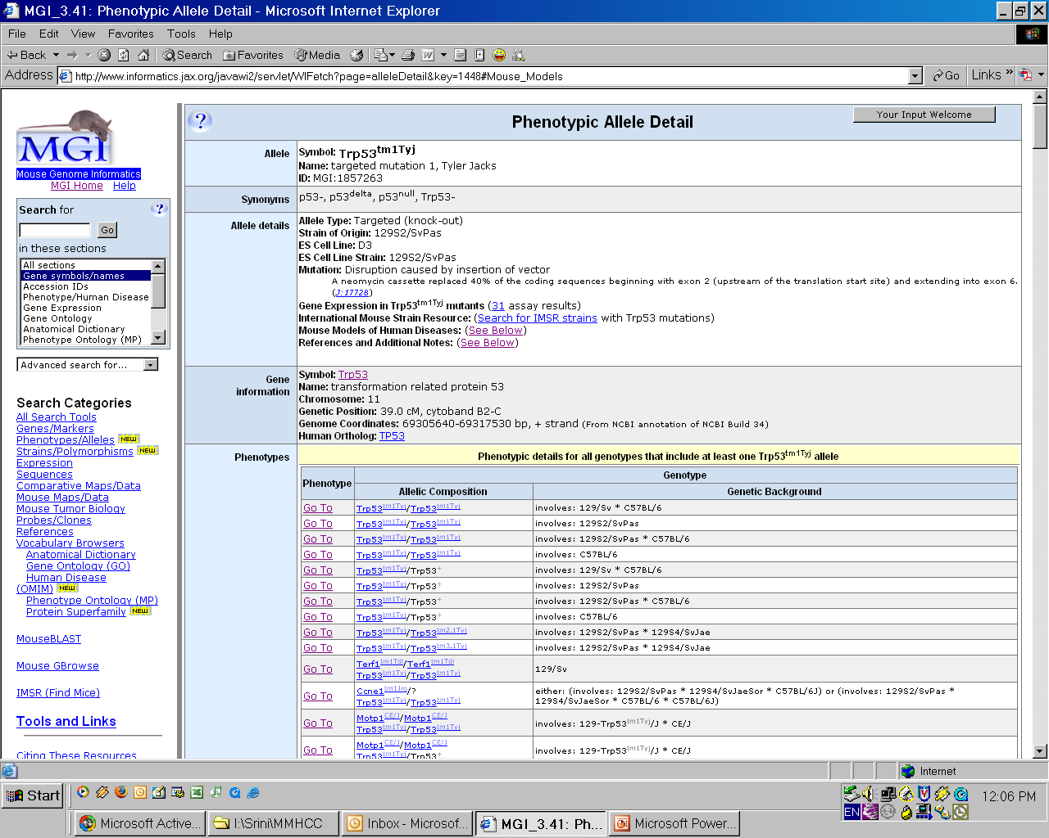
Add allele information to genetic description search pages

Slide 3
How to
List of All Mouse Phenotypic Alleles (tab-delimited)
MGI Allele Accession ID
Allele Symbol
Allele Name
Allele Type
PubMed ID for original reference
MGI Marker Accession ID
Marker Symbol
Marker RefSeq ID
Marker Ensembl ID
Mammalian Phenotype ID (comma-delimited)

Slide 4
Report is in CVS: docs\artifacts\Requirements\Integration with Jax
File name: MGI_PhenotypicAllele.rpt.txt

Slide 5
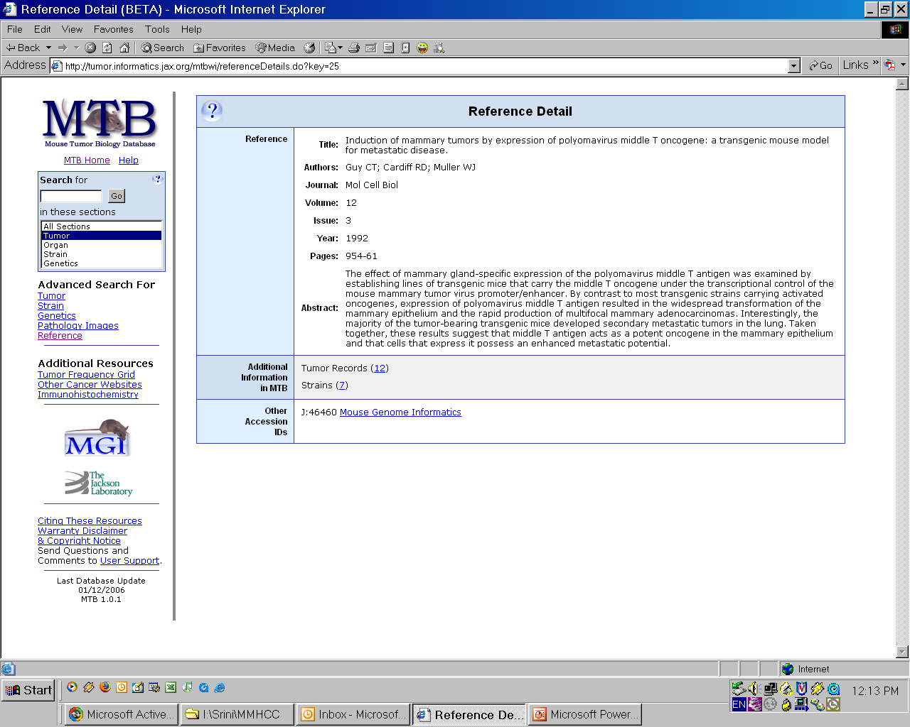
Link to references in MTB
(provide link on caMOD Publication page for all publications that have matches)

Slide 6
How to - 1
Jax provides report which lists J: number and PMID
Report is in CVS: docs\artifacts\Requirements\Integration with Jax
File name: BIB_PubMed_rpt.txt

Slide 7
How to - 2
Use author, journal, issue, volume etc to query BIB reference table in MGI

Slide 8
Strain List
Jax provides report which lists strain name and MGI number for strain
Report is in CVS: docs\artifacts\Requirements\Integration with Jax
File name: MGI_Strain.txt
Strain list contains 156 strains
This list will become the controlled strain vocabulary

Slide 9
Displaying MTB data in caMOD

Slide 10
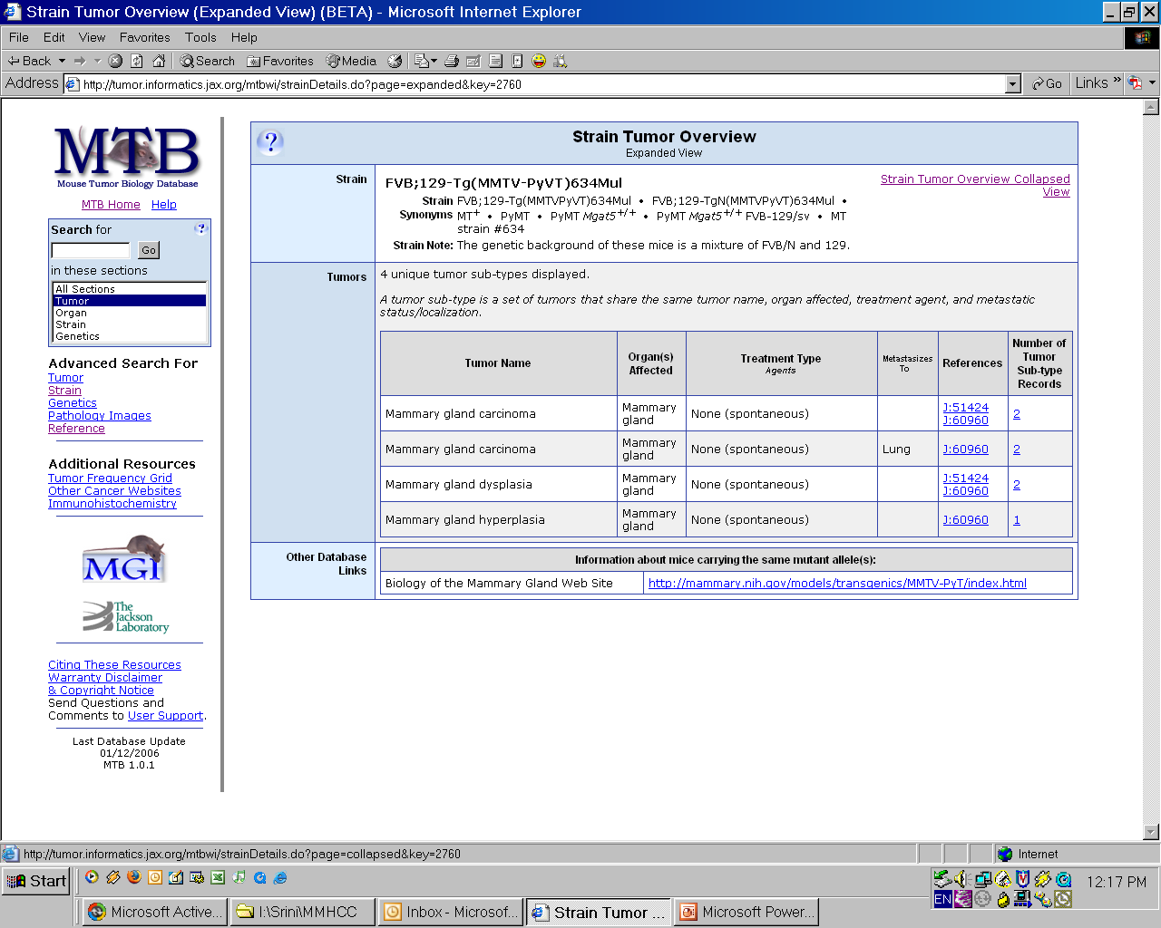

Slide 11
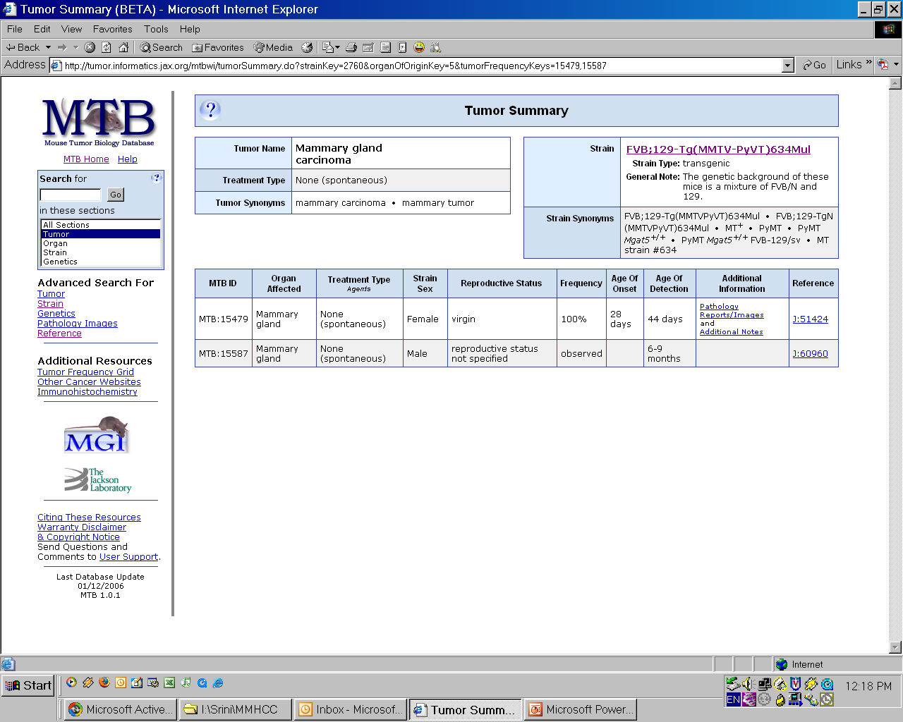

Slide 12
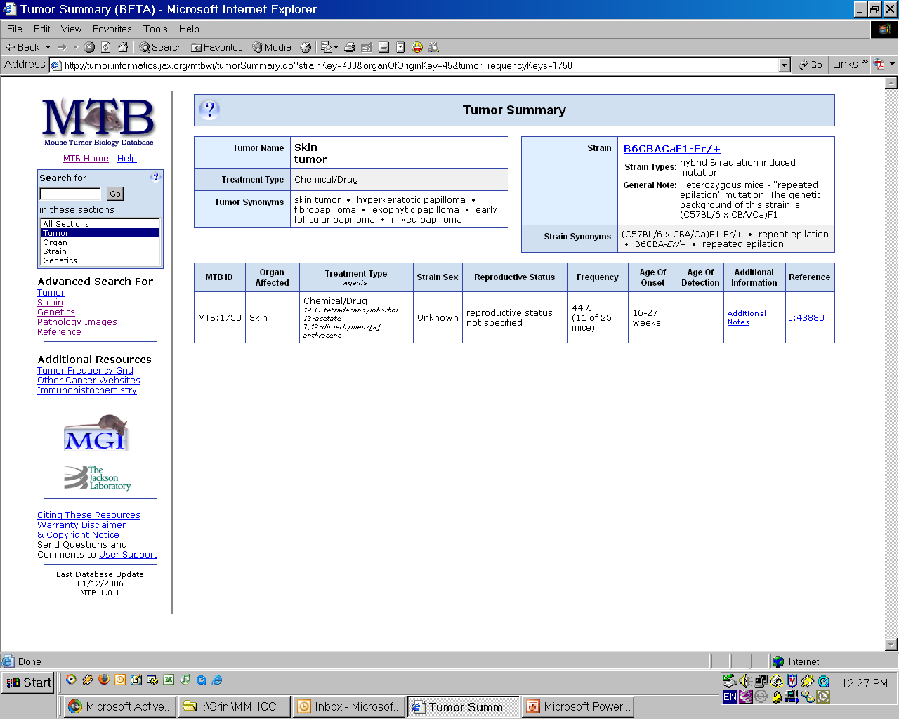

Slide 13
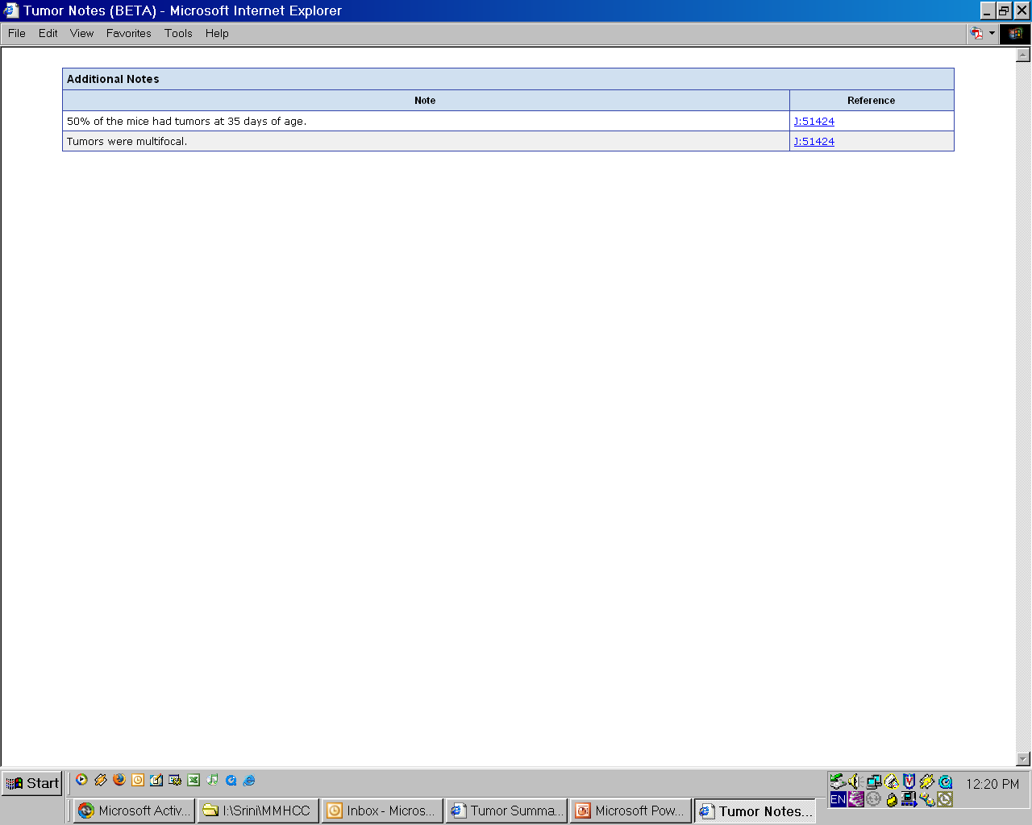

Slide 14
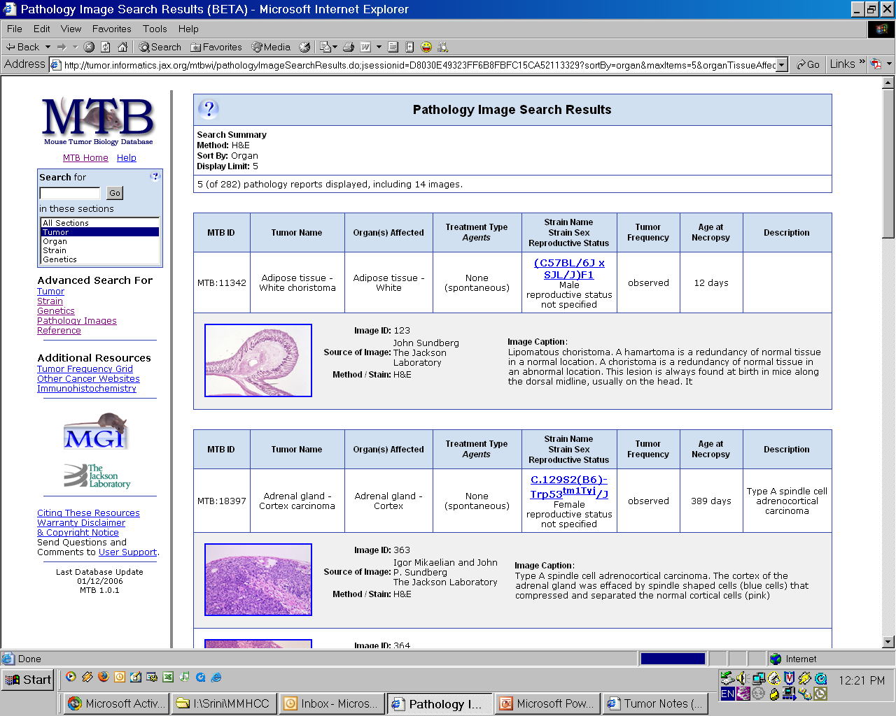

Slide 15
Nomenclature
First step: Allele nomenclature on genetic description pages
Next steps???

